Slide 1
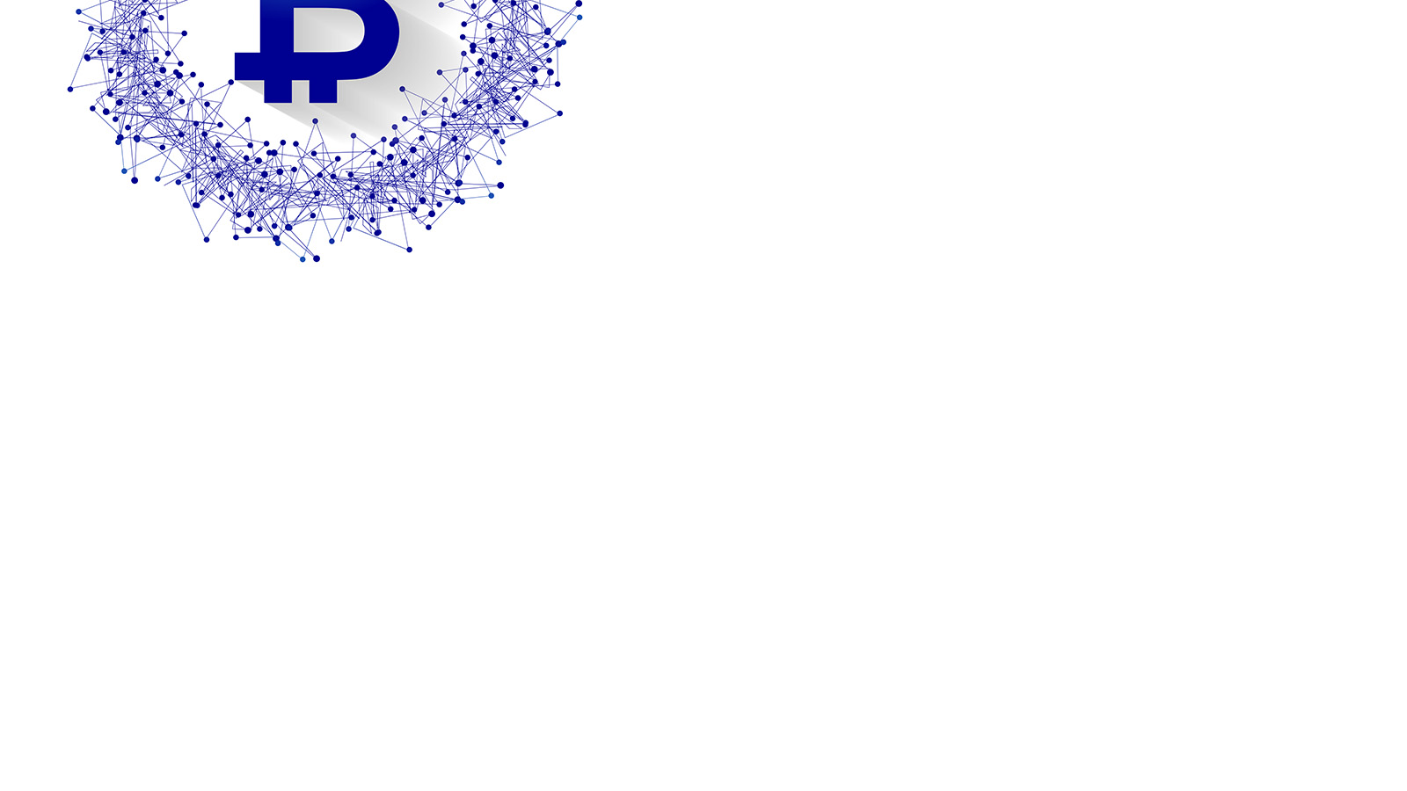


STUDENTS :
1-Abrar ALotaibi
2- Bushra ALsultan
3- Shorouq Alanzi
4- Lama Alanzi
SUPERVISOR:
DR : Nisreen Innab
Department of Computer Science, Information Systems and Health Information Systems
BAKKAH Application

Slide 2

INTRODUCTION :
Designing an electronic wallet for pilgrims to be dealt with inside the Kingdom during the Hajj season, and shipped at the airport upon arrival, and the rest is retrieved at the airport upon departure.

Slide 3
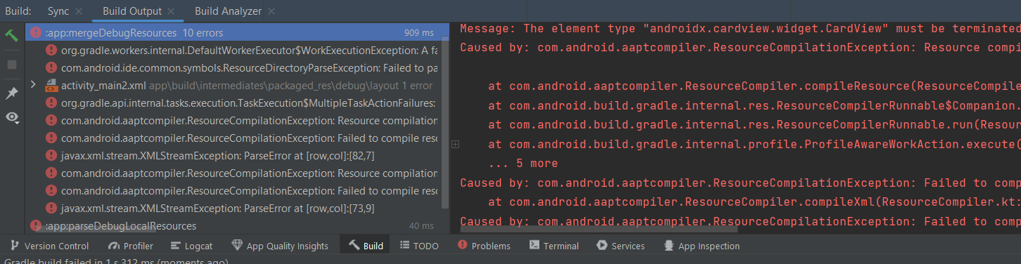
1- In the beginning, we used Android Studio , but we faced problems due to the weight of the program.
Problems :

Slide 4

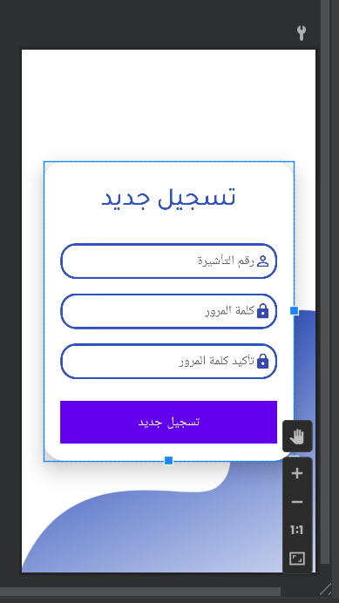
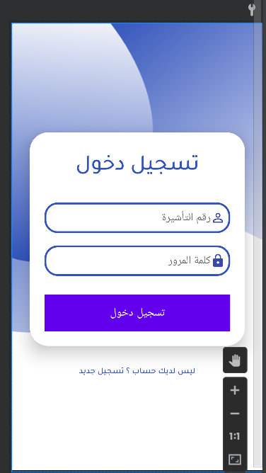
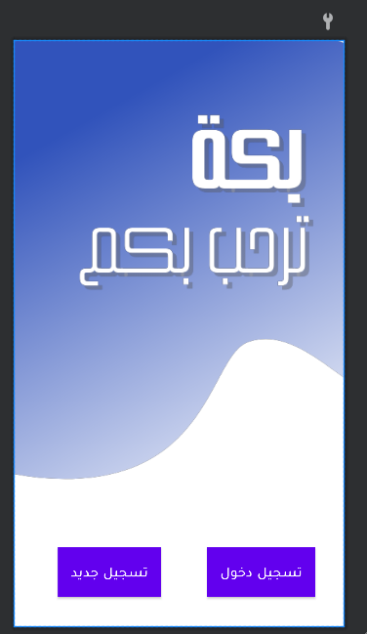

Slide 5

2- I started the journey of searching for a language other , and this took our time, and at the LEAP conference, we heard about the of flutter.
Problems

Slide 6
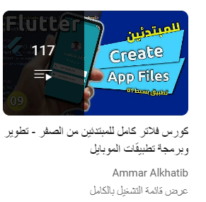
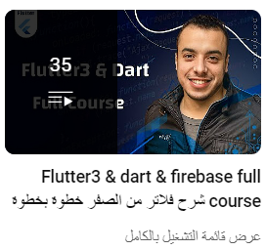
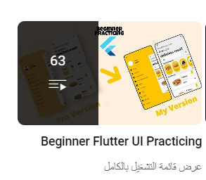
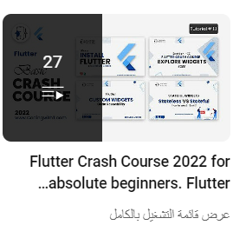
4- Learn a language Dart and flutter .
Problems

Slide 7
5- The difficulty of linking the database with the language of flutter (difficulty supporting other programming languages)
Problems

Slide 8
Flutter
flutter is an open source software development toolkit developed by Google to build user interfaces for Android, iOS, Windows and web applications.

Slide 9





Tools

Slide 10
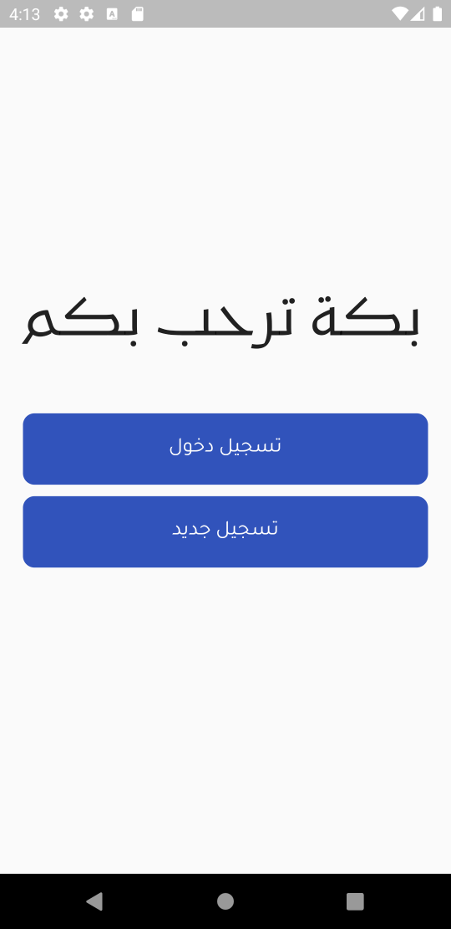
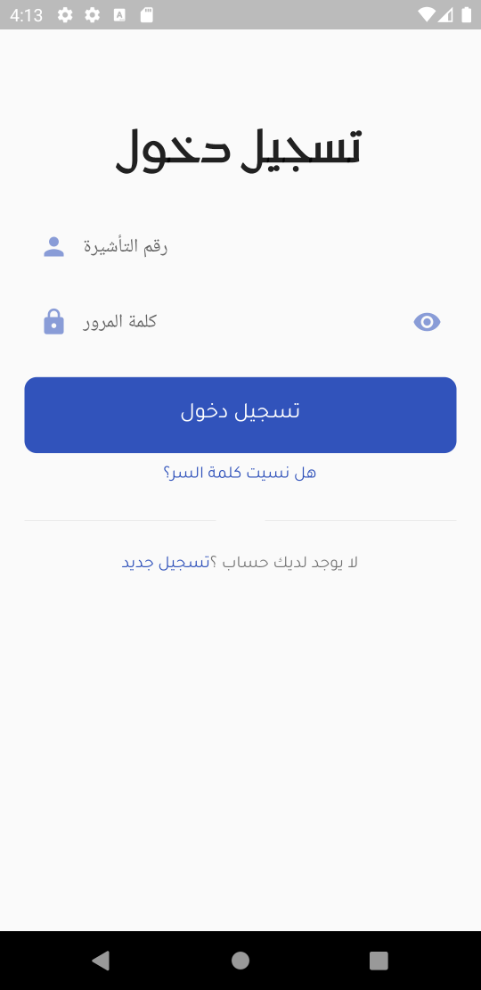
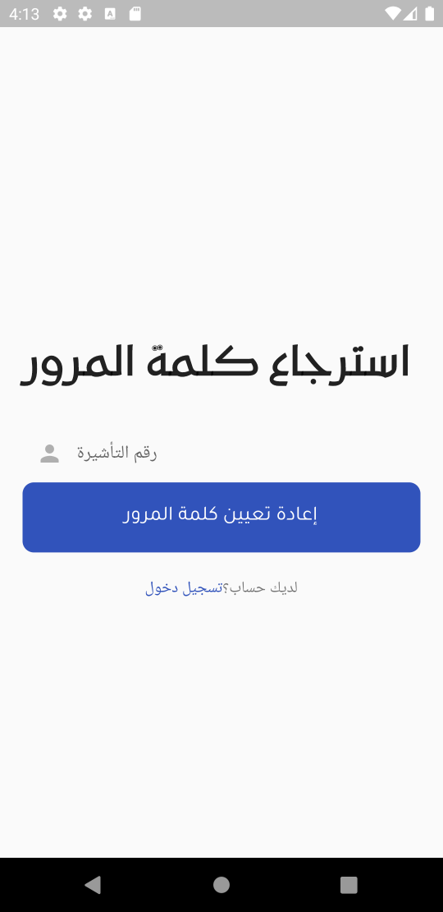
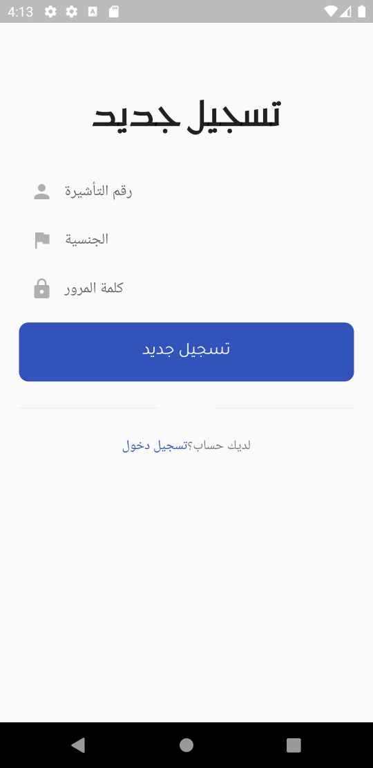

Slide 11
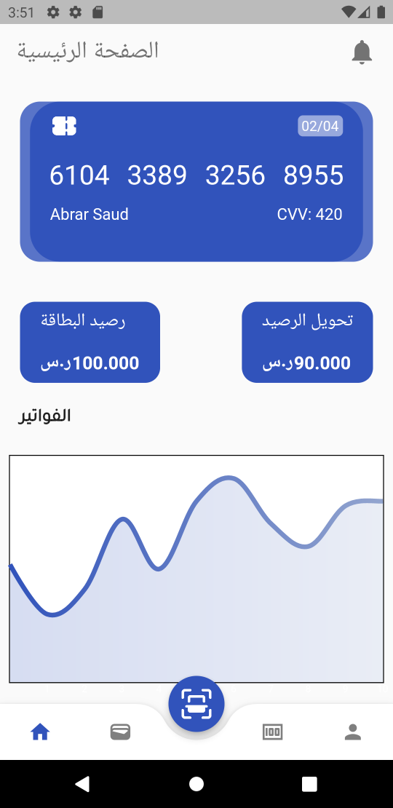
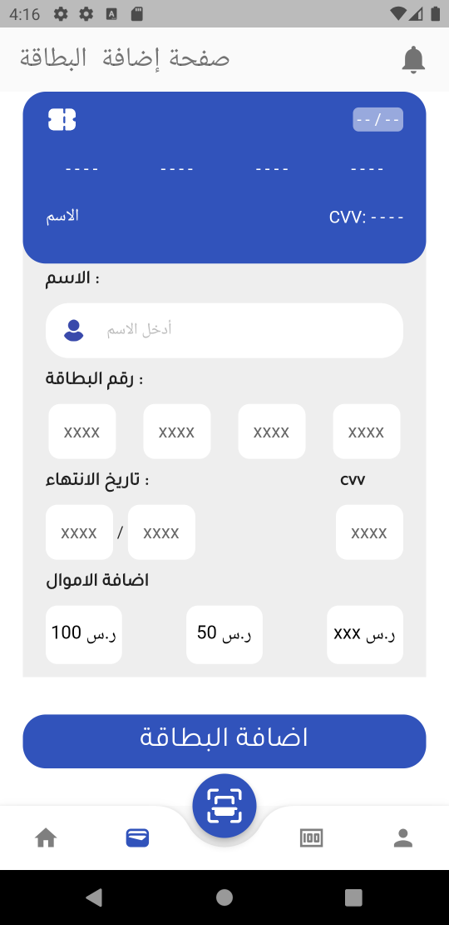
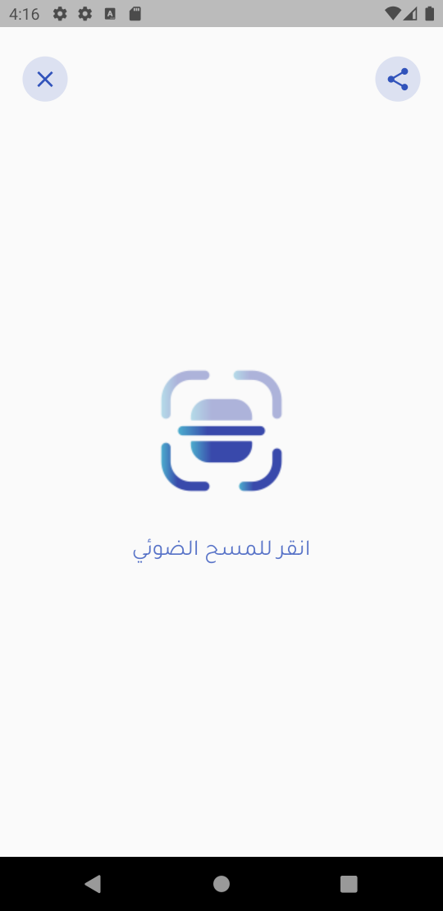

Slide 12
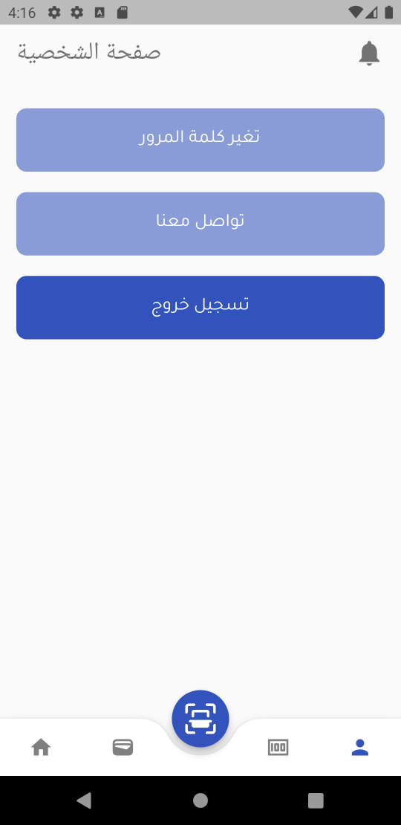
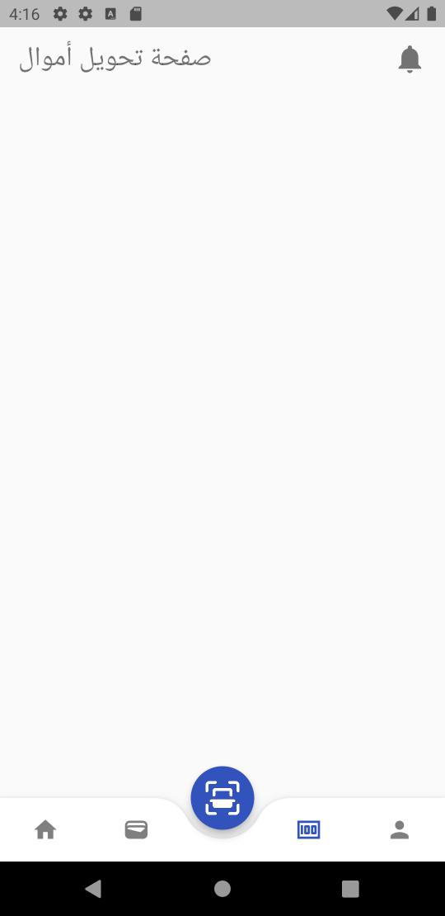

Slide 13
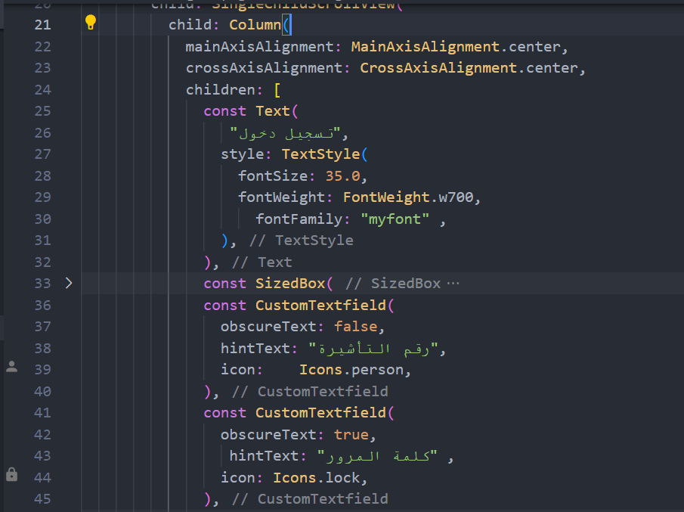
Login

Slide 14
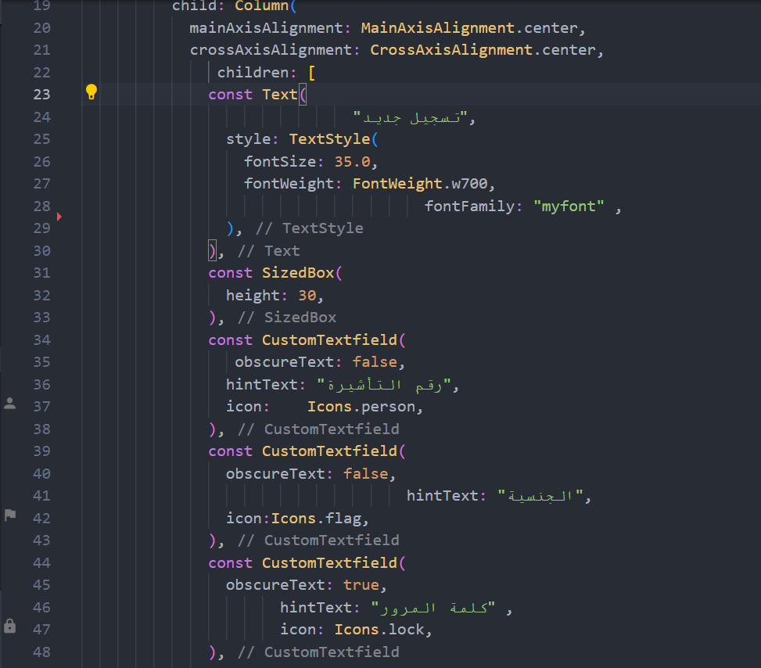
Login

Slide 15
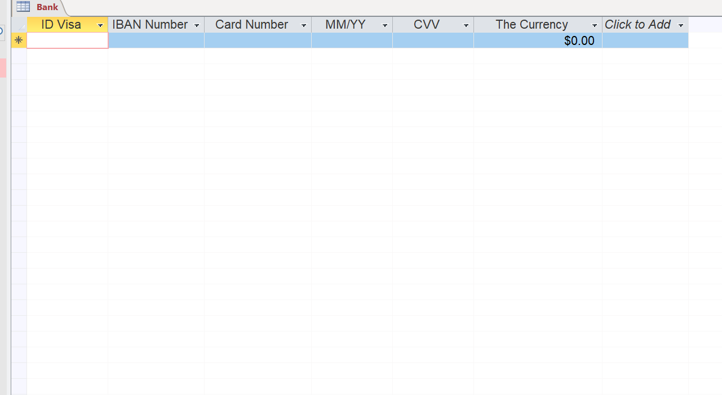
Database

Slide 16
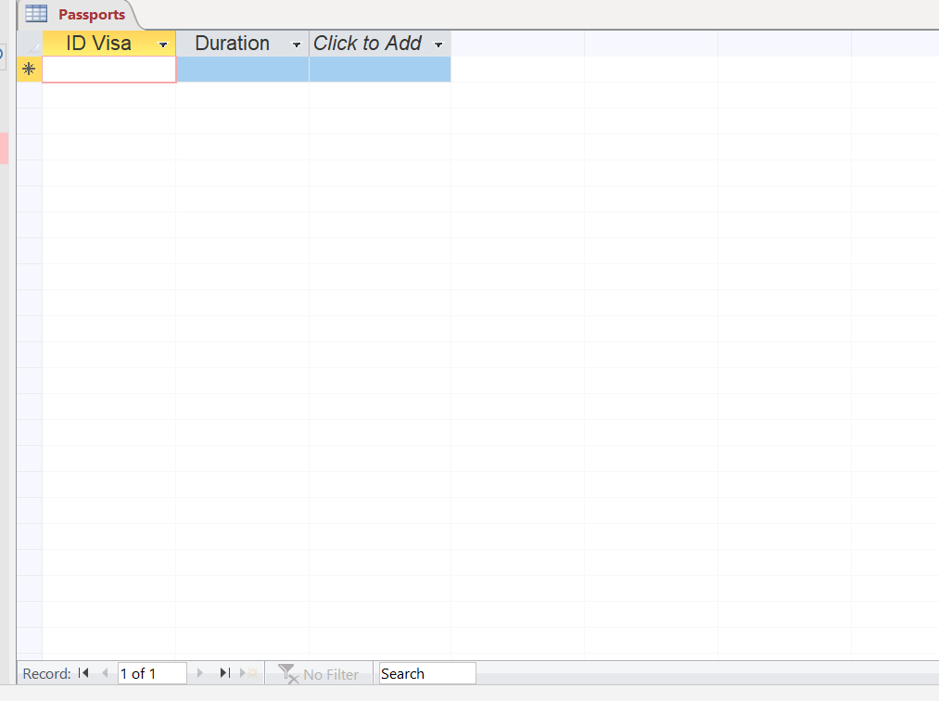

Slide 17
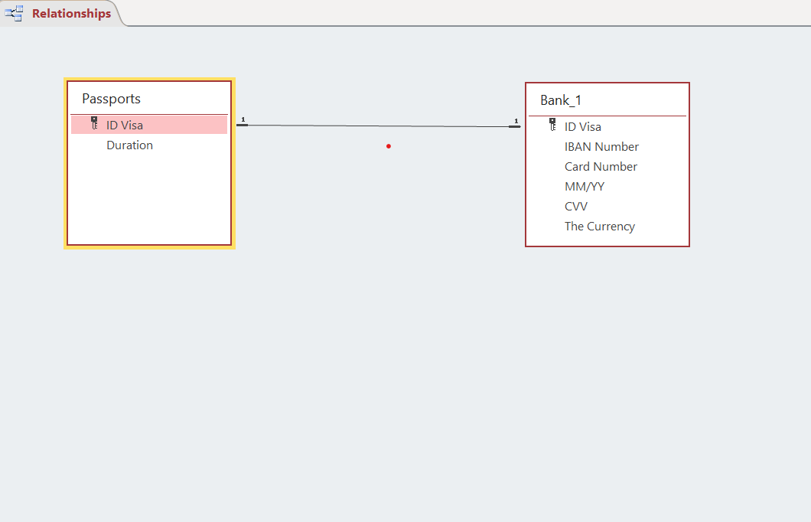

Slide 18
THANKS, YOU ALL

